Slide 1
Analyzing Marketing Effectiveness
PRESENTED BY:
Sandhya
Shabiha Rayeen
Pooja
Maheshwari
Nurenisha

Slide 2

INTRODUCTION
Explore the dynamics of advertising impact on product sales with this synthesized dataset. Created using R programming language, the dataset comprises seven columns representing advertising costs on various platforms — TV, Billboards, Google Ads, Social Media, Influencer Marketing, and Affiliate Marketing. The last column, 'Product_Sold' quantifies the corresponding number of units sold.

Slide 3

OBJECTIVE FUNCTION
To compare different types of advertisement
To explore factors affecting product sales graphically
To predict product sales using MLR

Slide 4
DATA
TV | Billboards | Google_Ads | Social_Media | Influencer | Affiliate | Product_Sold
281.42 | 538.8 | 123.94 | 349.3 | 242.77 | 910.1 | 7164
702.97 | 296.53 | 558.13 | 180.55 | 781.06 | 132.43 | 5055
313.14 | 295.94 | 642.96 | 505.71 | 438.91 | 464.23 | 6154
898.52 | 61.27 | 548.73 | 240.93 | 278.96 | 432.27 | 5480
766.52 | 550.72 | 651.91 | 666.33 | 396.33 | 841.93 | 9669
507.13 | 612.27 | 230.67 | 142.96 | 171.79 | 965.77 | 7627
486.64 | 555.02 | 203.26 | 271.62 | 70.04 | 366.25 | 5177
762.09 | 184.57 | 176.61 | 97.85 | 116.67 | 251.74 | 3726
638.6 | 778.31 | 796.32 | 759.04 | 857.13 | 515.16 | 9801
591.48 | 542.51 | 400.23 | 329.15 | 577.38 | 931.65 | 8652
667.17 | 577.85 | 898.19 | 970.28 | 789.52 | 852.99 | 11210
787.33 | 947.73 | 884.15 | 992.3 | 871.55 | 742.36 | 12227
537.75 | 865.19 | 768.61 | 626.87 | 702.96 | 211.92 | 8093
735.78 | 661.81 | 282 | 102.96 | 588.45 | 585.74 | 7181
631.14 | 207.04 | 939.62 | 358.88 | 515.59 | 778.49 | 7910

Slide 5

SUMMARY
Groups | Count | Sum | Average | Variance
TV | 300 | 155229.3 | 517.431 | 83010.134
Billboards | 300 | 150793.48 | 502.6449 | 76089.013
Google_Ads | 300 | 153733.24 | 512.4441 | 81465.933
Social_Media | 300 | 146940.03 | 489.8001 | 75012.399
Influencer_Marketing | 300 | 139719.77 | 465.7326 | 83125.008
Affiliate_Marketing | 300 | 145329.19 | 484.4306 | 77259.237
ANOVA
Source of Variation | SS | df | MS | F | P-value | F crit
Between Groups | 558059.35 | 5 | 111611.9 | 1.4069854 | 0.218637311 | 2.2190855
Within Groups | 142312555 | 1794 | 79326.95
Total | 142870615 | 1799
ONE WAY ANOVA

Slide 6


GRAPHICAL REPRESENTATION OF MARKETING EFFECTIVENESS

Slide 7
SUM GRAPH
Groups
TV
Billboards
Google_Ads
Social_Media
Influencer_Marketing
Affiliate_Marketing
Sum
155229.3
150793.48
153733.24
146940.03
139719.77
145329.19

Slide 8
AVERAGE GRAPH
Groups
TV
Billboards
Google_Ads
Social_Media
Influencer_Marketing
Affiliate_Marketing
Average
517.431
5.6449
512.4441
489.8001
465.7326
484.4306

Slide 9

PIE CHART FOR sum percentage

Slide 10
Multiple Linear Regression
Linear relationship developed from more than 1 predictor variable
Simple linear regression:
y = b + m*x
y = β0 + β1 * x1
Multiple linear regression:
y = β0 + β1*x1 + β2*x2 … + βn *xn
βi is a parameter estimate used to generate the linear curve
Simple linear model: β1 is the slope of the line
Multiple linear model: β1 , β2, etc. work together to generate a linear curve
β0 is the y-intercept (both cases)

Slide 11


Response variable (Y)
TV | Billboards | Google_Ads | Social_Media | Influencer | Affiliate | Product_Sold
281.42 | 538.8 | 123.94 | 349.3 | 242.77 | 910.1 | 7164
702.97 | 296.53 | 558.13 | 180.55 | 781.06 | 132.43 | 5055
313.14 | 295.94 | 642.96 | 505.71 | 438.91 | 464.23 | 6154
898.52 | 61.27 | 548.73 | 240.93 | 278.96 | 432.27 | 5480
766.52 | 550.72 | 651.91 | 666.33 | 396.33 | 841.93 | 9669
Multiple linear regression:
y = β0 + β1*x1 + β2*x2+…. β6x6

Slide 12

Multiple Linear Regression Assumptions
For any given value of X, the distribution of Y must be normal.
For any given value of X, of Y must have equal variances.
We can again check this by using the Shapiro Test and residual plots on the residuals of your model.
No multicollinearity.
No autocorrelation.

Slide 13

CODES OF ‘R’
my_data=read.csv(file.choose(),header = T)
attach(my_data)
pairs(~Product_Sold+TV+Billboards+Google_Ads+Social_Media+Affiliate_Marketing+Influencer_Marketing)

Slide 14
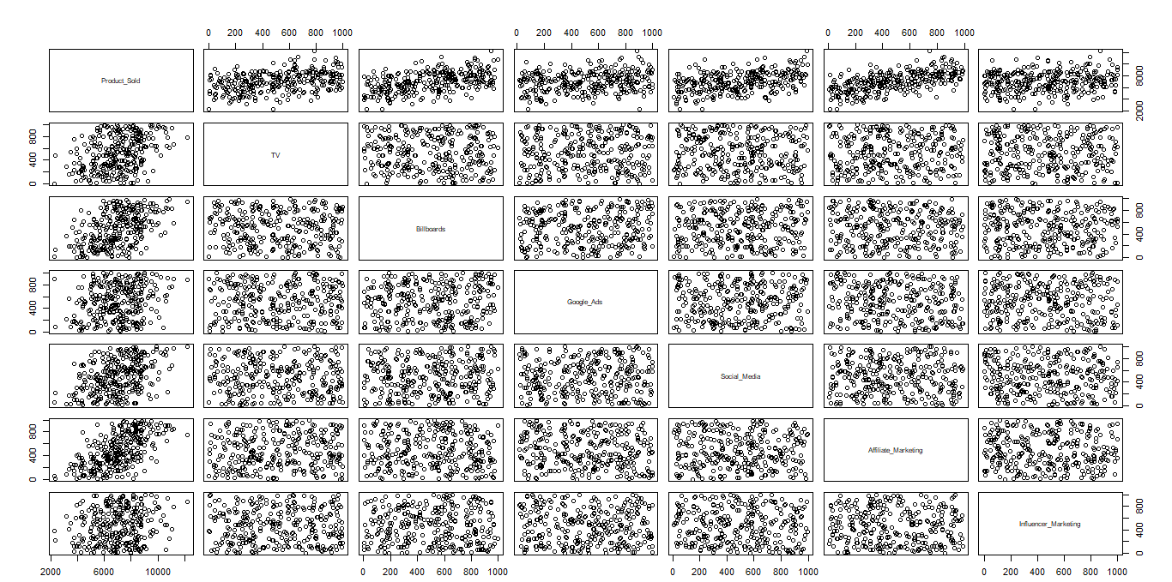

Slide 15
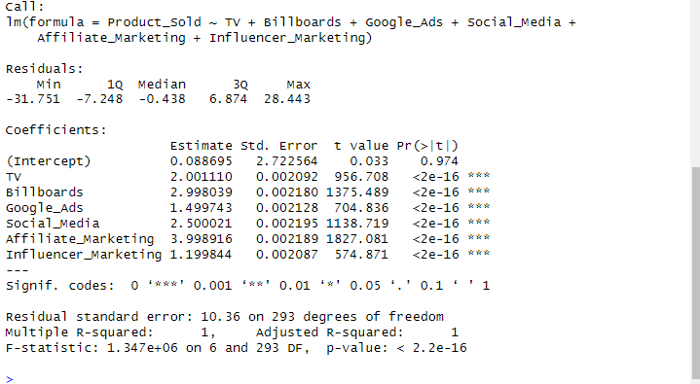
model1=lm(Product_Sold~TV+Billboards+Google_Ads+Social_Media+Affiliate_Marketing+Influencer_Marketingsummary(model1)
OUTPUT
Using t-test explanatory variables are significant.
Using F-test the model is significant.

Slide 16
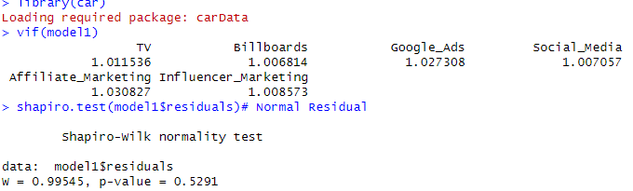
library(car)
vif(model1)
shapiro.test(model1$residuals)
OUTPUT
Since all values of VIF lies between 1 to 5. Therefore there is no multicollinearity present in the data.
Using Shapiro test residuals are normally distributed.

Slide 17
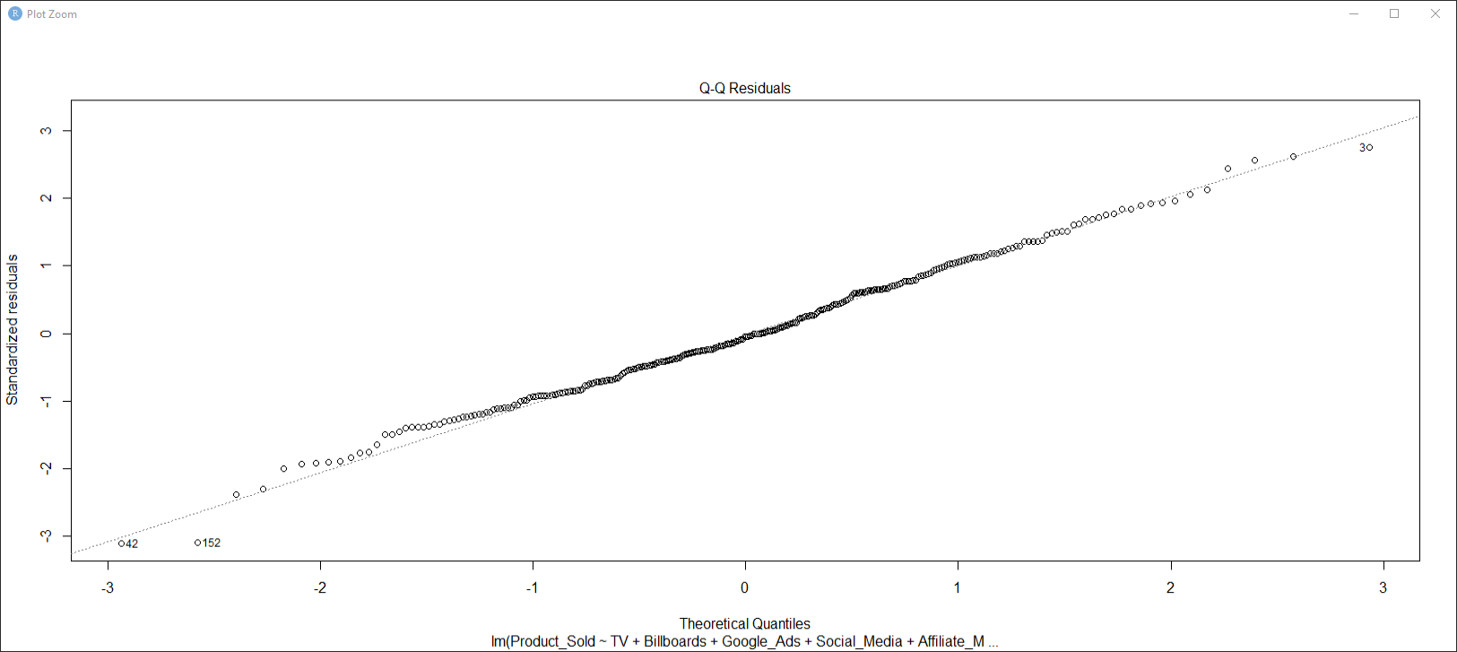
Normal residual
plot(model1,2)
Using Quantile graph the residuals are normally distributed.
OUTPUT:

Slide 18
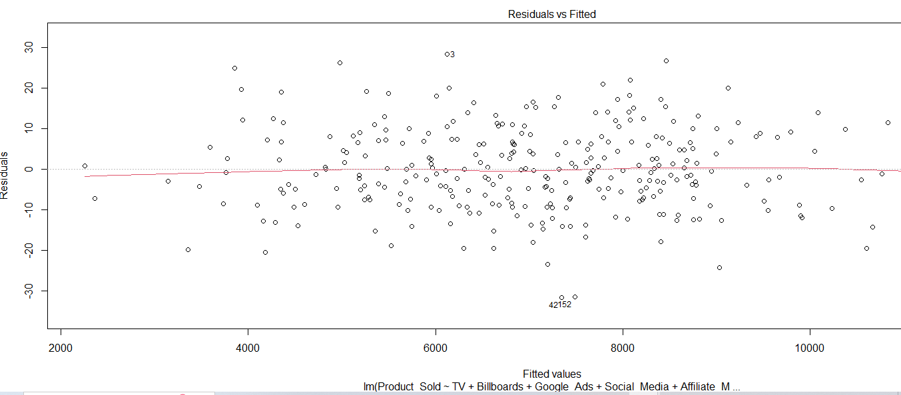
Homoscedastic data Graph
plot(model1,1)

Slide 19

CONCLUSION FOR Homoscedastic data Graph
As points are randomly distributed there is a presence of homoscedastic in the data i.e equal variance
This Photo by Unknown Author is licensed under CC BY

Slide 20

NO AUTOCORRELATION
durbinWatsonTest(model1$residuals)
(lmtest)bptest(model1)
library(MASS)
m1=step(lm(Product_Sold~TV+Billboards+Google_Ads+Social_Media+Affiliate_Marketing+Influencer_Marketing),direction = "both")

Slide 21
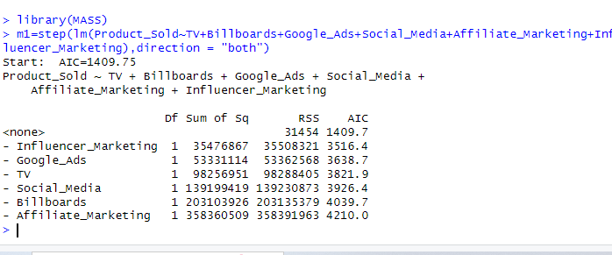
OUTPUT
AIC of the model is 1409.7

Slide 22
CONCLUSION FOR NO AUTOCORRELATION
The Durbin-Watson statistic, if it falls within the acceptable range (approximately 1.5 to 2.5), you can conclude that there is no significant autocorrelation in the residuals of the regression model.

Slide 23
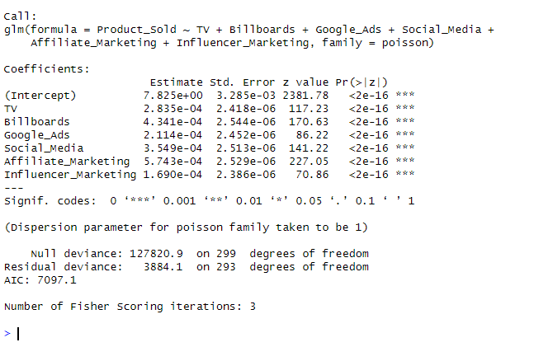
Poisson Regression
Regressionmodel2=glm(Product_Sold~TV+Billboards+Google_Ads+Social_Media+Affiliate_Marketing+Influencer_Marketing,family=poisson)summary(model2)
OUTPUT:
AIC of the model is 7097.1

Slide 24
CONCLUSION FOR Poisson Regression
Since AIC of the multiple linear regression is least, it is the best model.

Slide 25

CONCLUSION
By using this model we can predict product sales.

Slide 26


